Slide 1

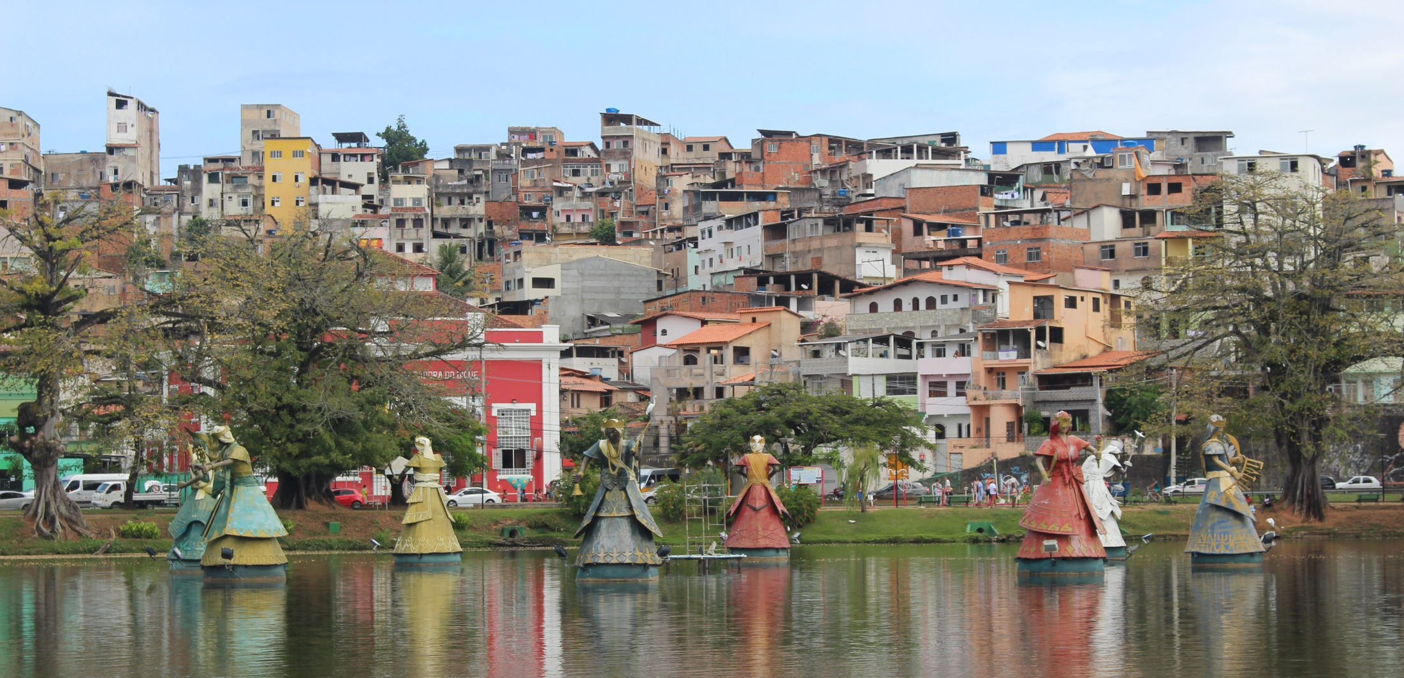
Lessons from Brazil
UDM Faculty Reflections/Curriculum Projects Discussion
Fulbright Hays gpas to brazil 2016-2022

Slide 2
U.S. Department of Education’s Fulbright Hays
Group Projects Abroad
Program Purpose
  To support overseas training, research and curriculum development in modern foreign languages and area studies.

Slide 3
Curriculum Enhancement Project
  Project Features:
Acquire first-hand resource materials including artifacts, books, documents, educational films, museum reproductions, recordings, and other instructional material for curriculum development in modern foreign language and area studies;
Provide for systematic use and dissemination in the United States of the acquired materials; and
Resource materials include artifacts, books, documents, educational films, museum reproductions, recordings, and other instructional material.

Slide 4
3 Phases to the GPA
Pre-departure programming – UDM: Feb - June
Overseas experience - July
Follow-up phase – August – December – project submission + 2 year presentation period to follow.
Curriculum project implementation takes place when we return

Slide 5
Next: Fulbright Hays GPA to Brazil July 2024
- Attend Information session on September 21 during dead hour (1-2pm) in Briggs 108
- Send Intent to Apply email to Lara Wasner by October 1
- Submit application to Lara Wasner and Suzanne Lynch by November 1
- Hear back about your award December 15
- Travel to Brazil July of 2024!

Slide 6
Why Northeast Brazil?
We chose Brazil
  African continuities
  Contemporary issues
  Quilombo communities
  African American experiences throughout the Americas
  Linkage between Brazilian Portuguese and culture

Slide 7
Our projects
Enhance teaching
  Help us and our students make critical connections
Raise awareness and consciousness
Speak to our mission and identities
Catalyze research in other ways
Visit https://www.udmercy.edu/academics/academic-affairs/fulbright/gpa.php

Slide 8

Quilombo leader Mãe Bernadete killed Thursday, August 18, 2023 six years after son Flavio was murdered.
Her community Pitanga dos Palmares in Bahia is home to 289 families
16,000 Quilombola settlements are located in Salvador, Bahia, Brazil.
Quilombo communities are under constant threat in Brazil because of the monetary value of their ancestral land.

Slide 9
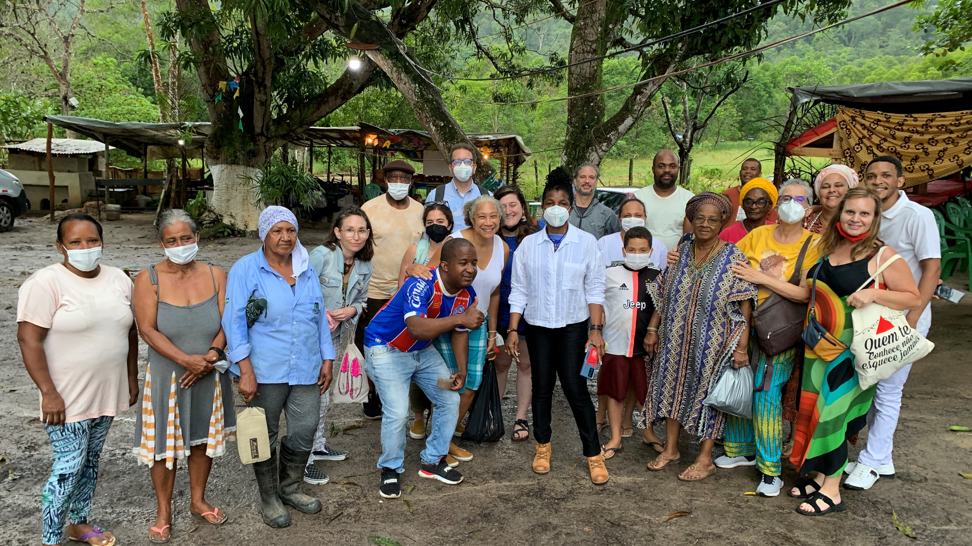

Slide 10
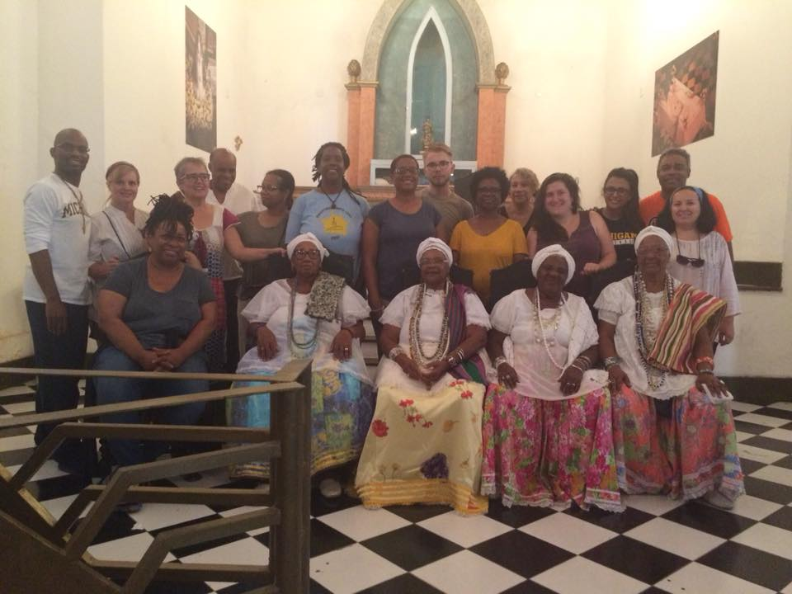
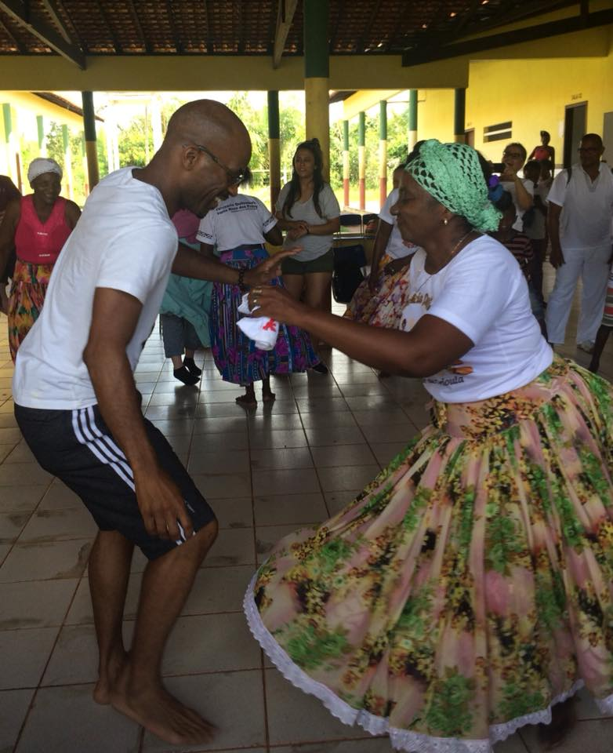
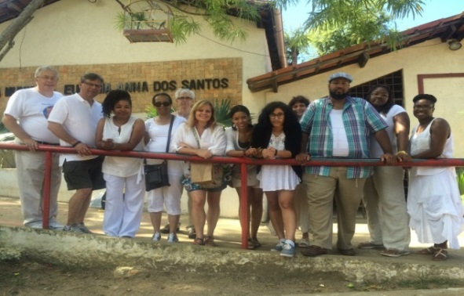
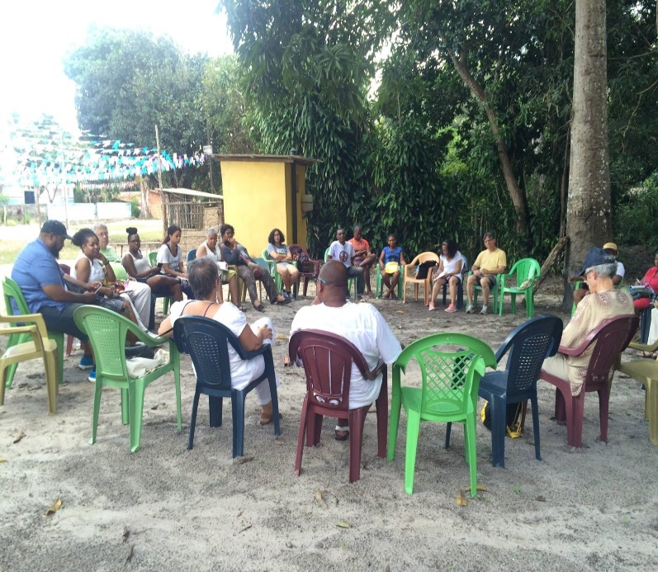

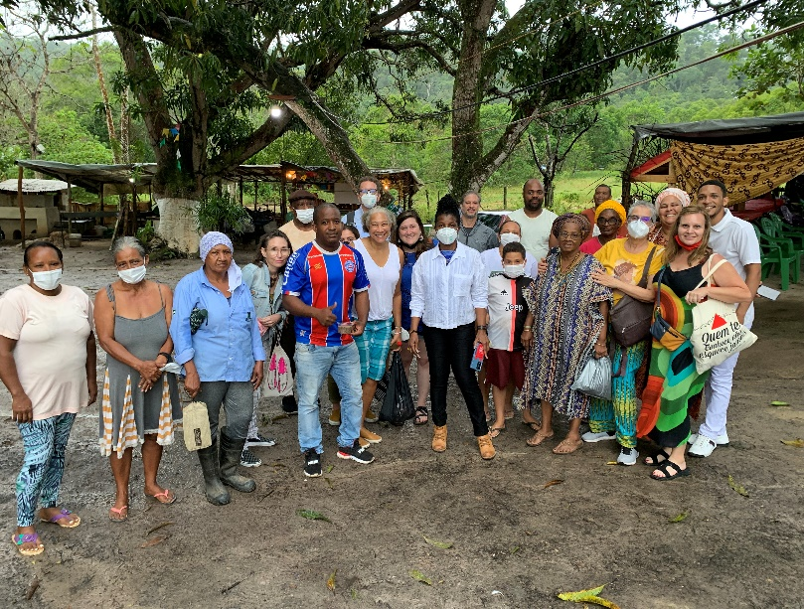

Slide 11
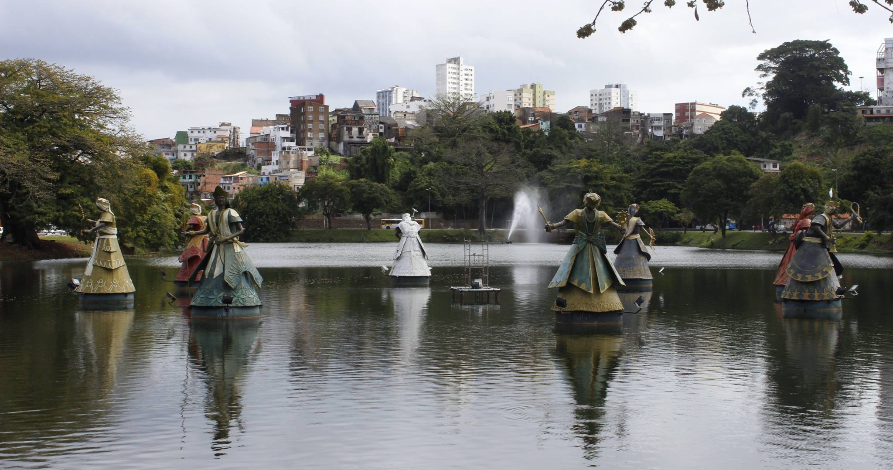

Slide 12


Slide 13
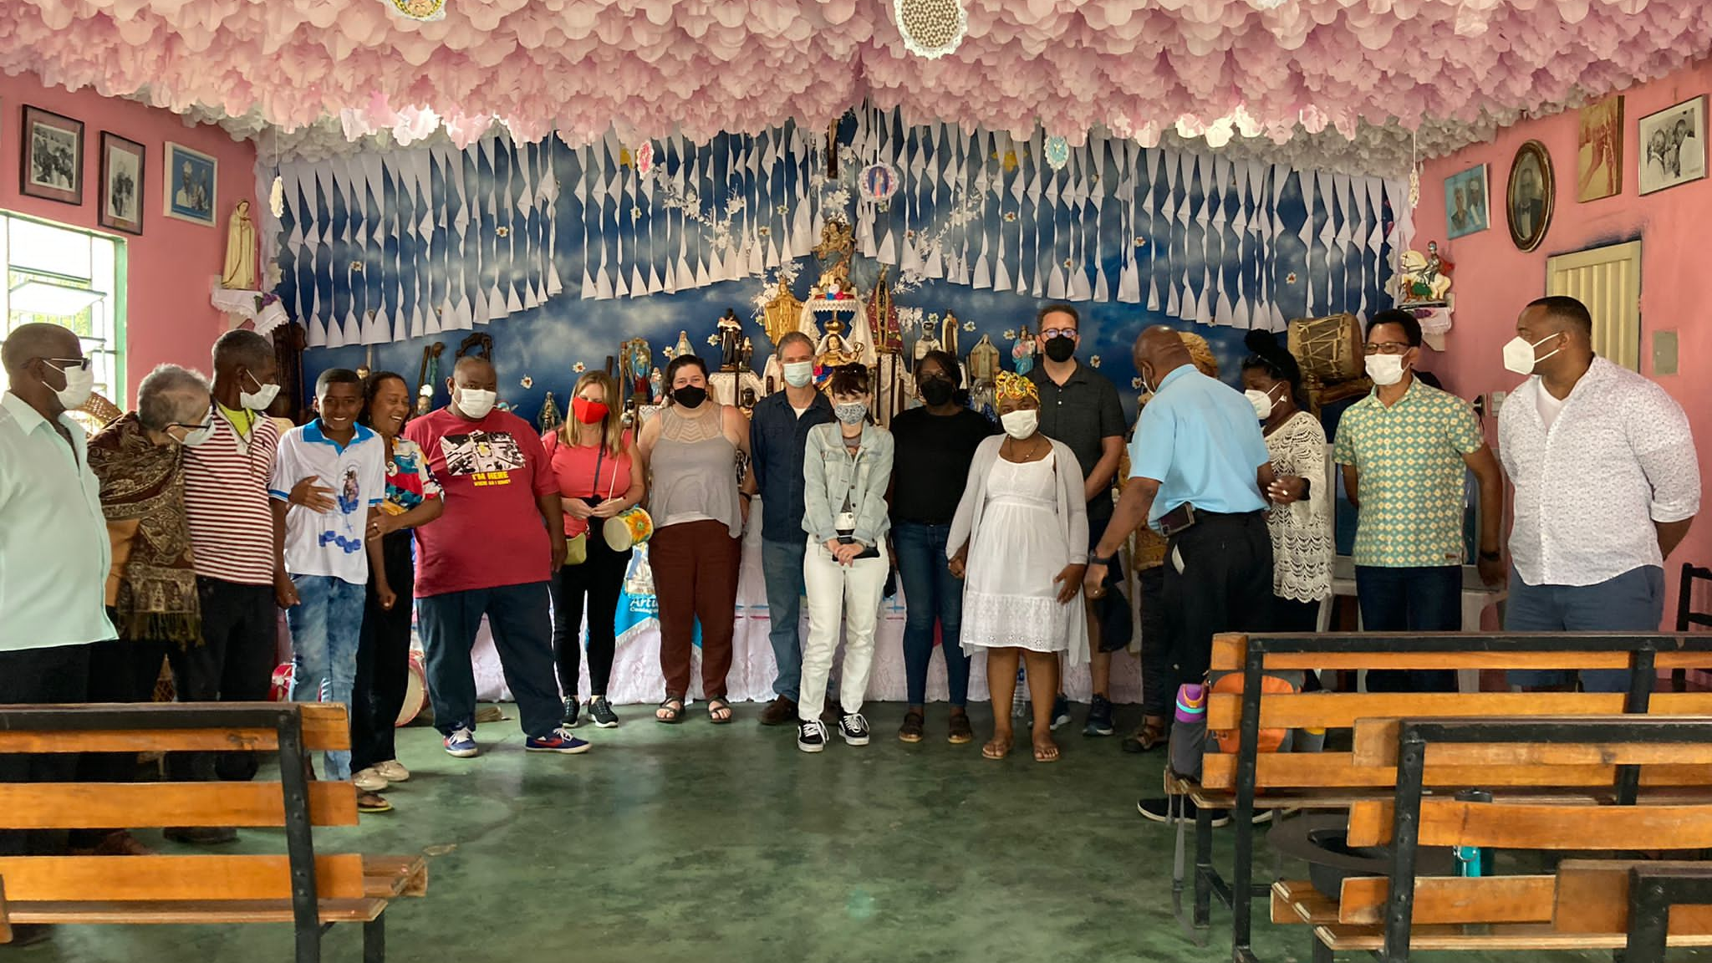

Slide 14


Slide 15
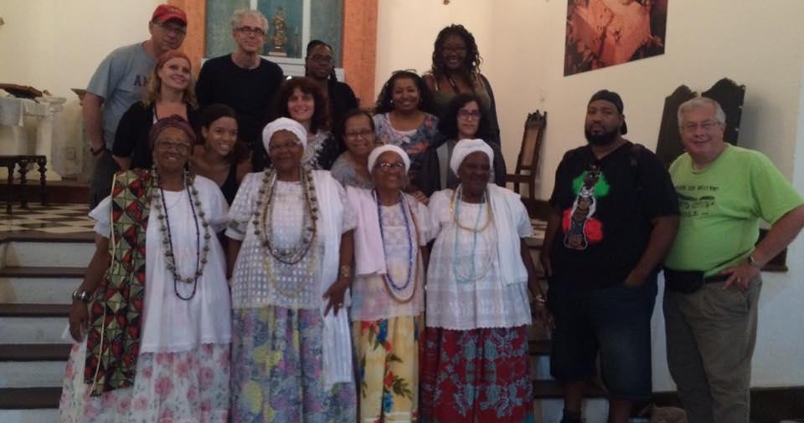

Slide 16
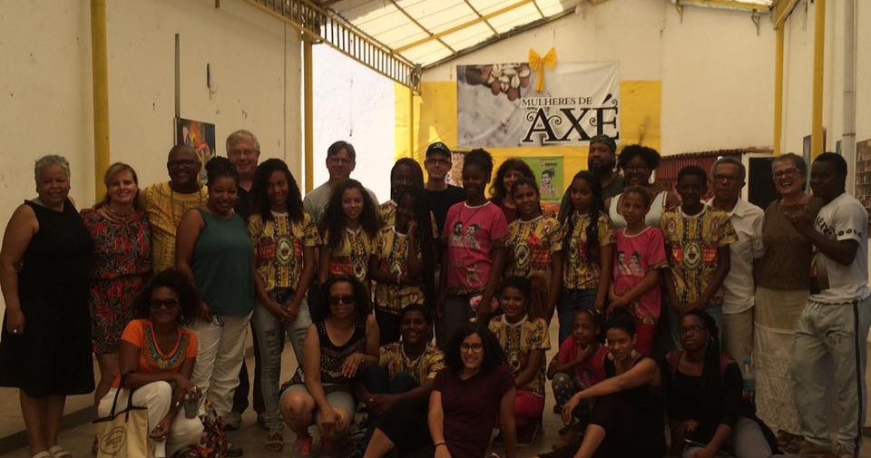

Slide 17
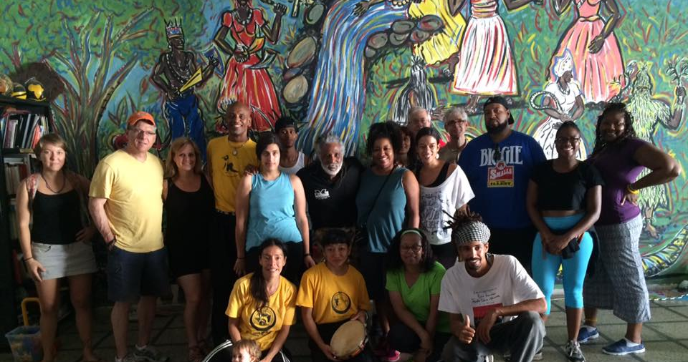

Slide 18
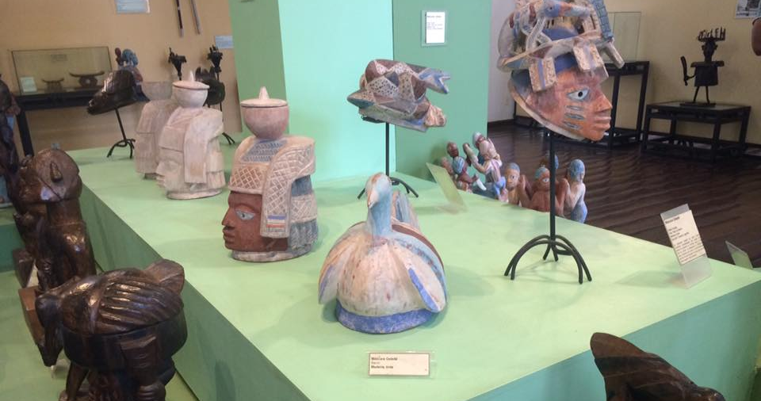

Slide 19
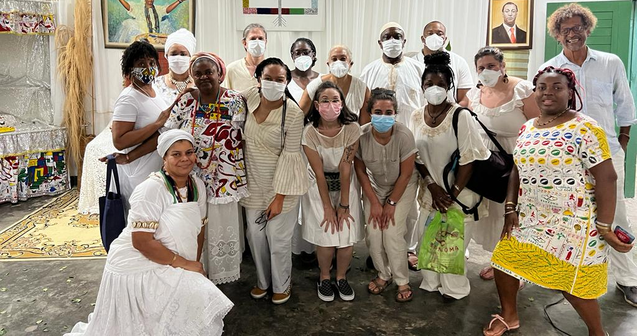

Slide 20
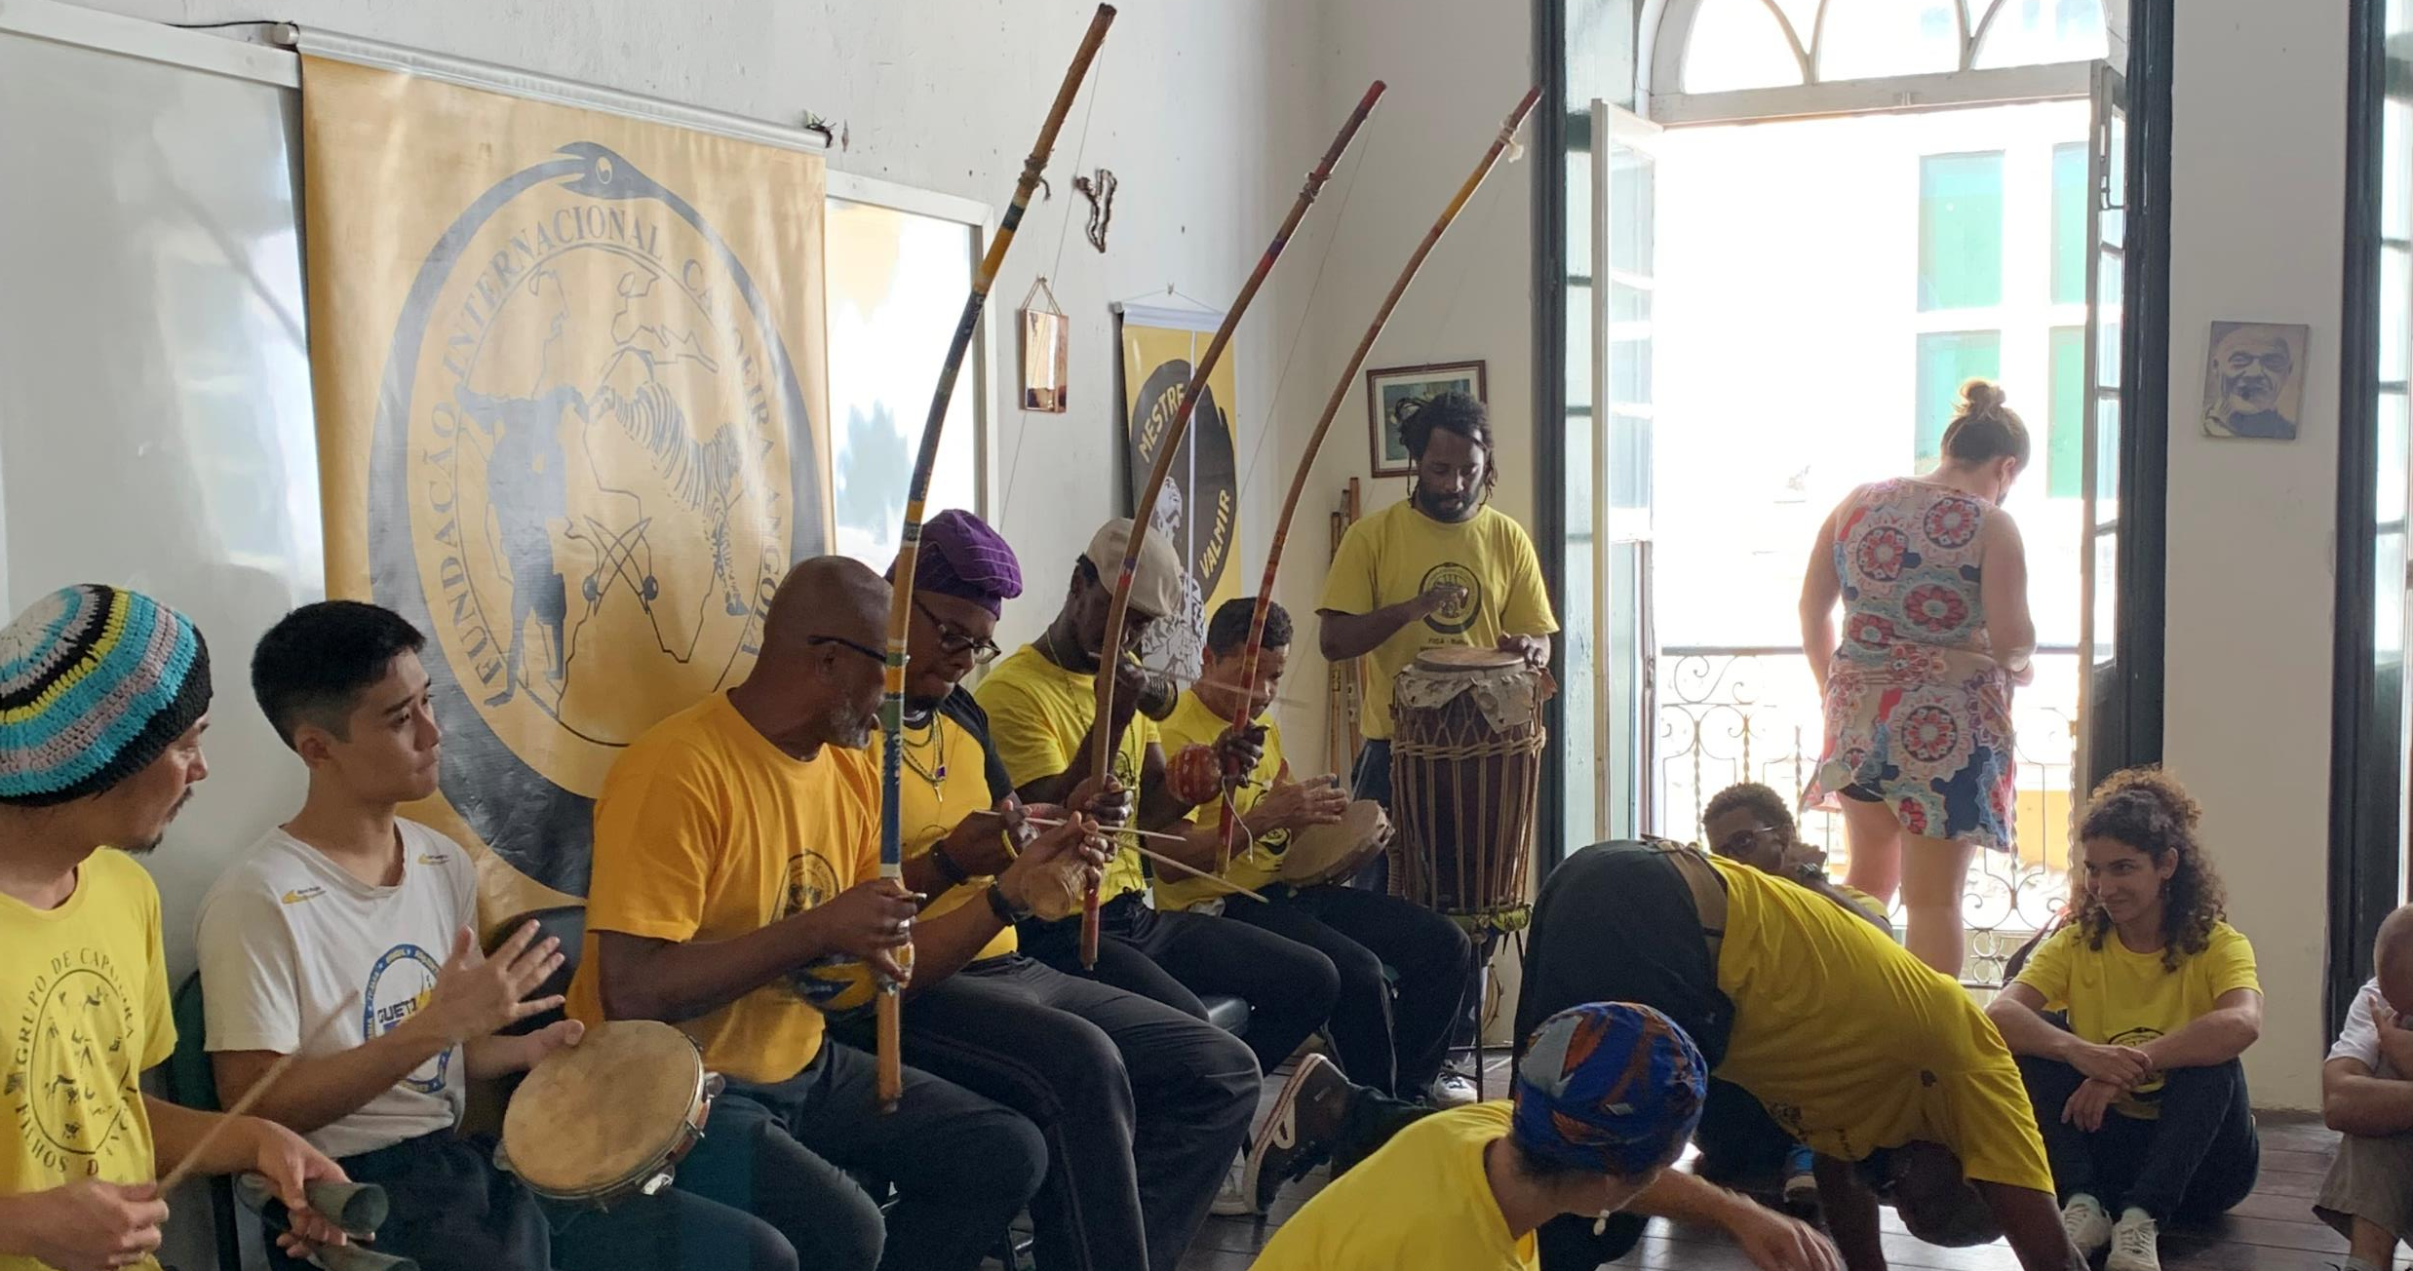

Slide 21
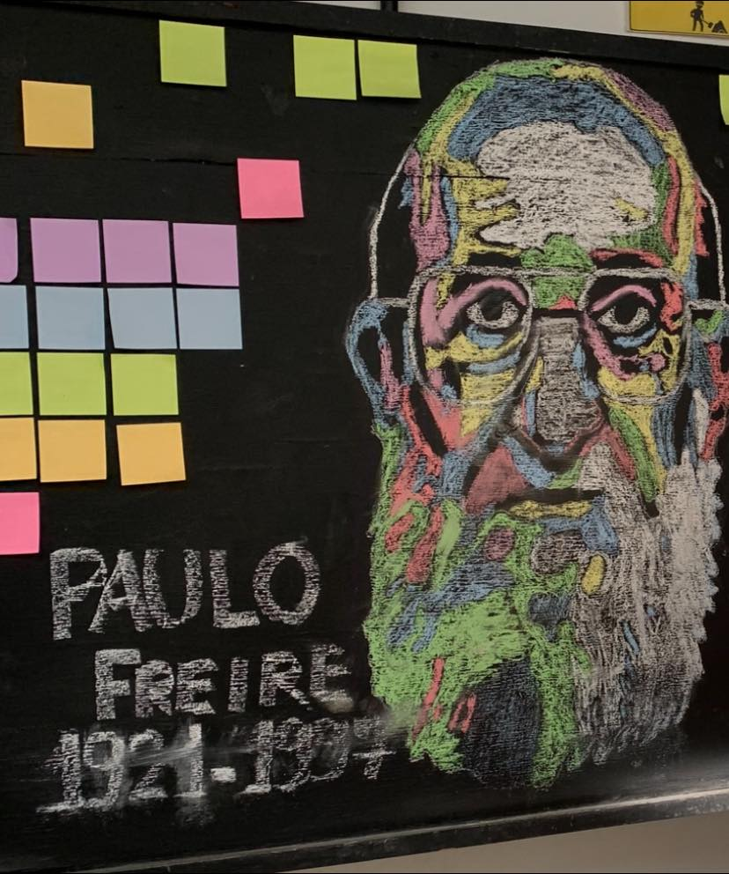

Slide 22
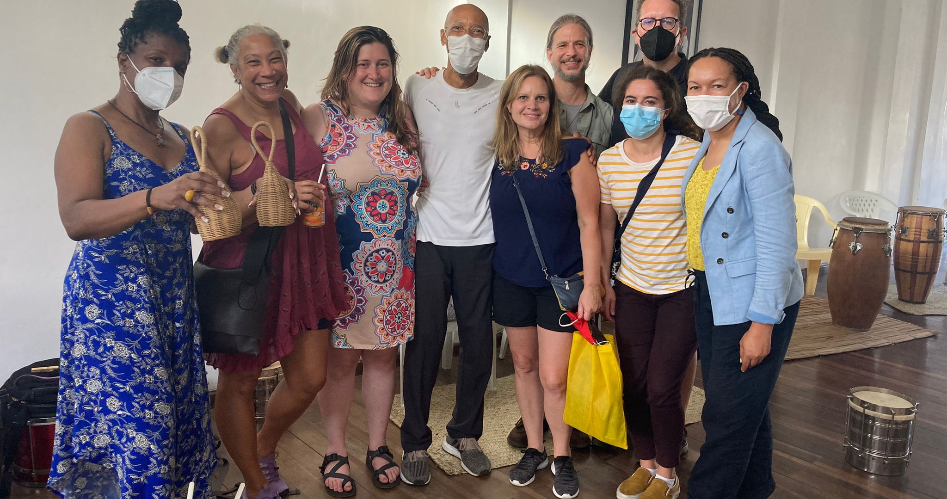

Slide 23
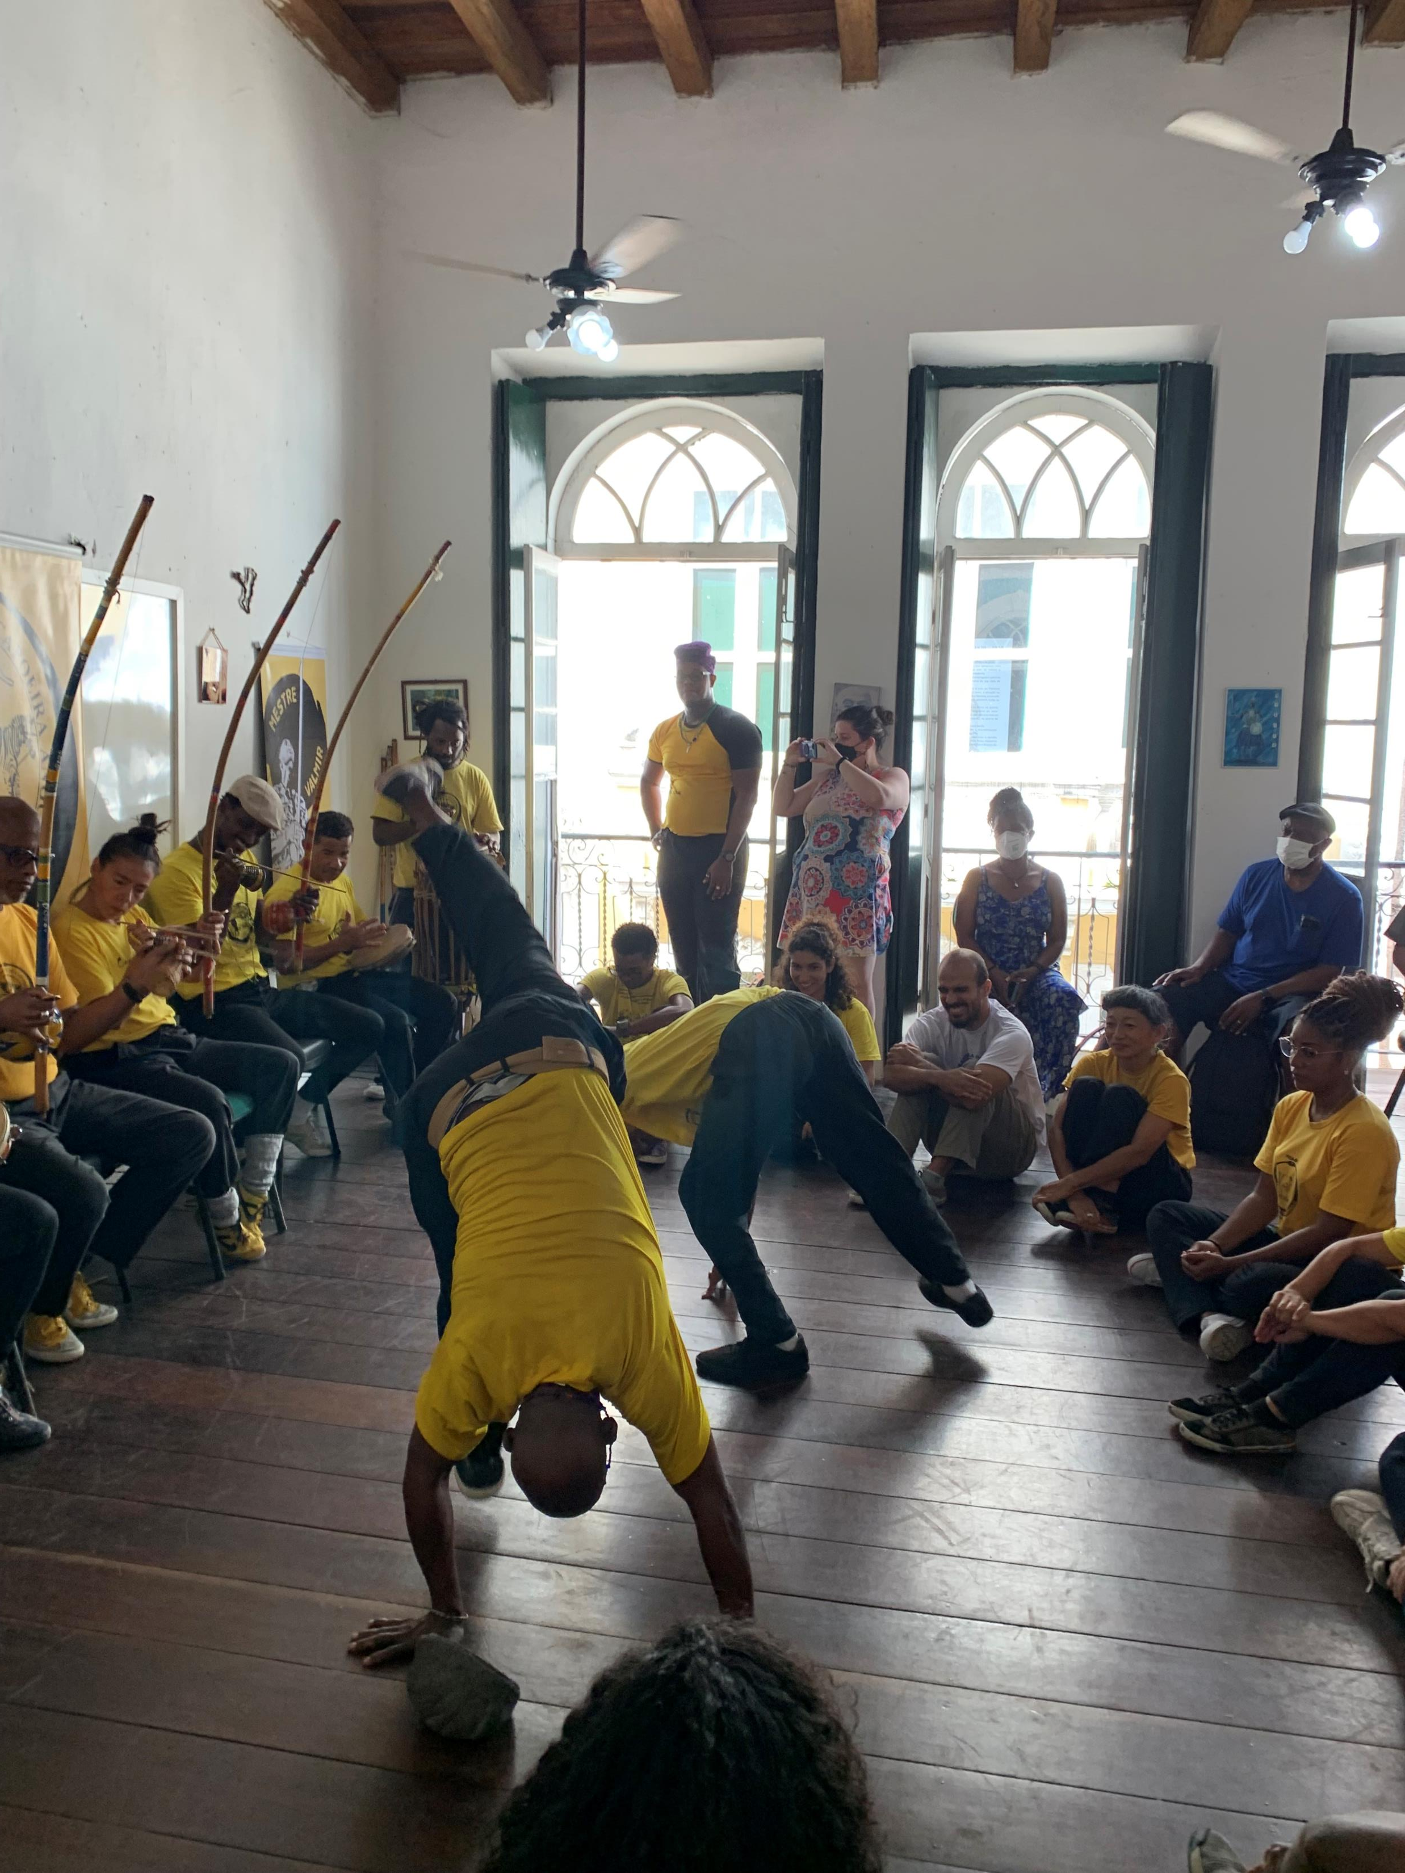

Slide 24
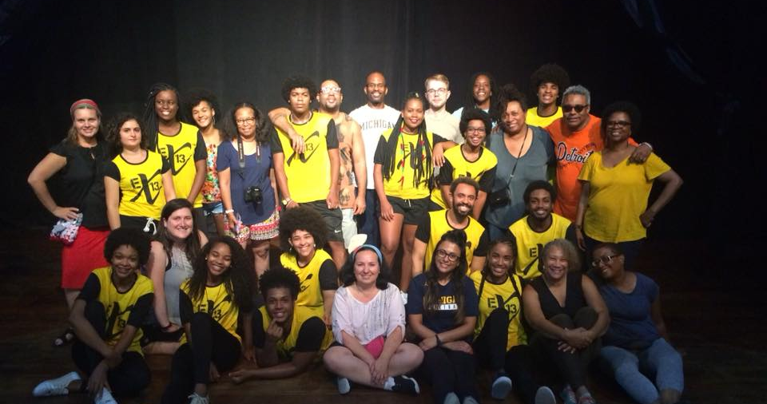

Slide 25
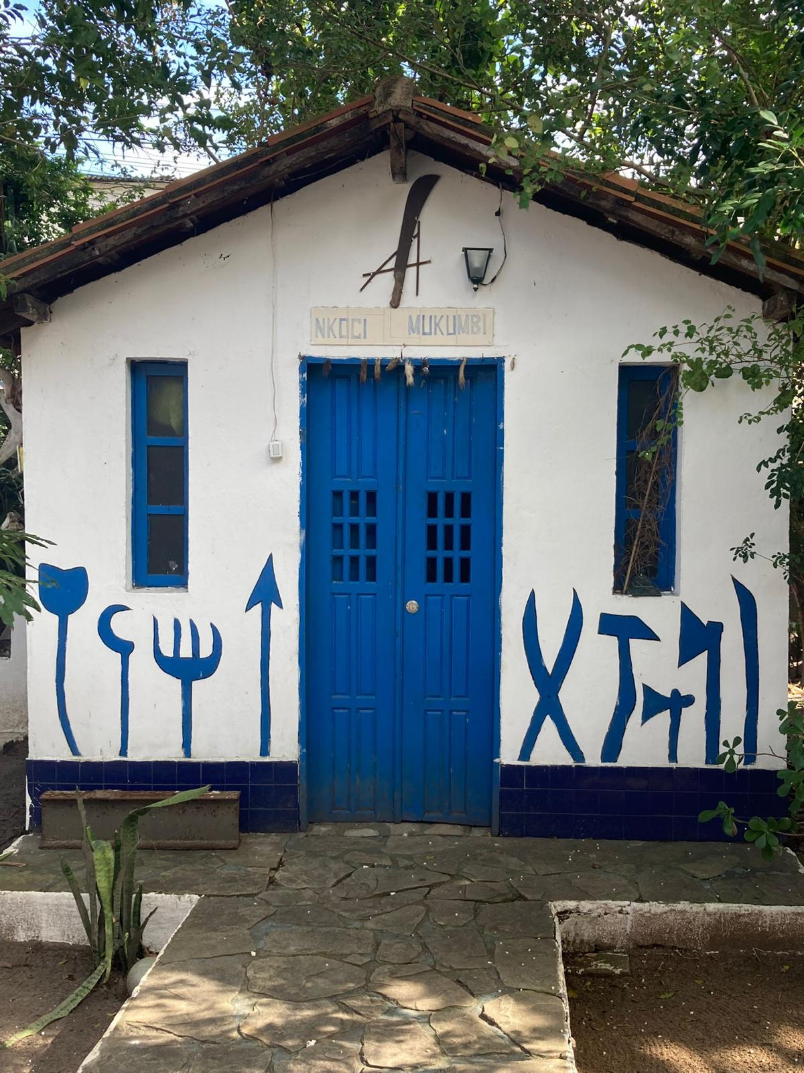

Slide 26
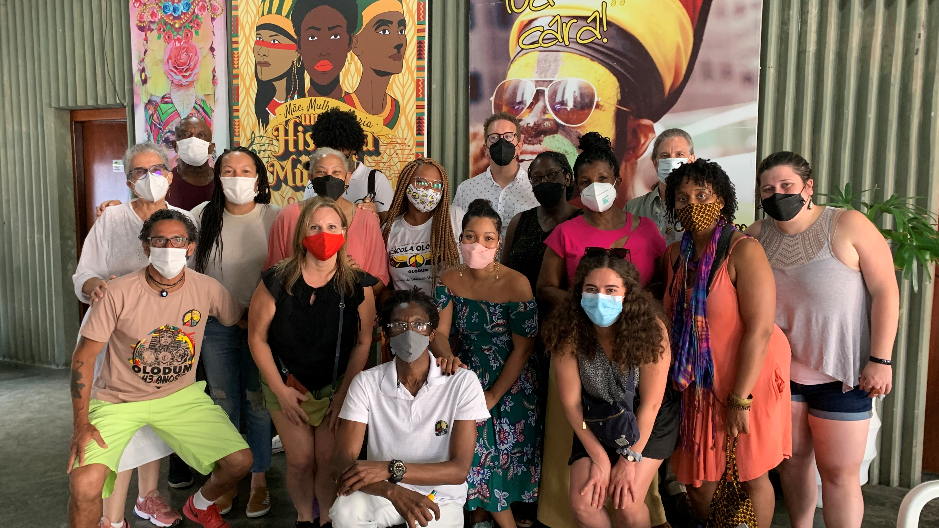

Slide 27
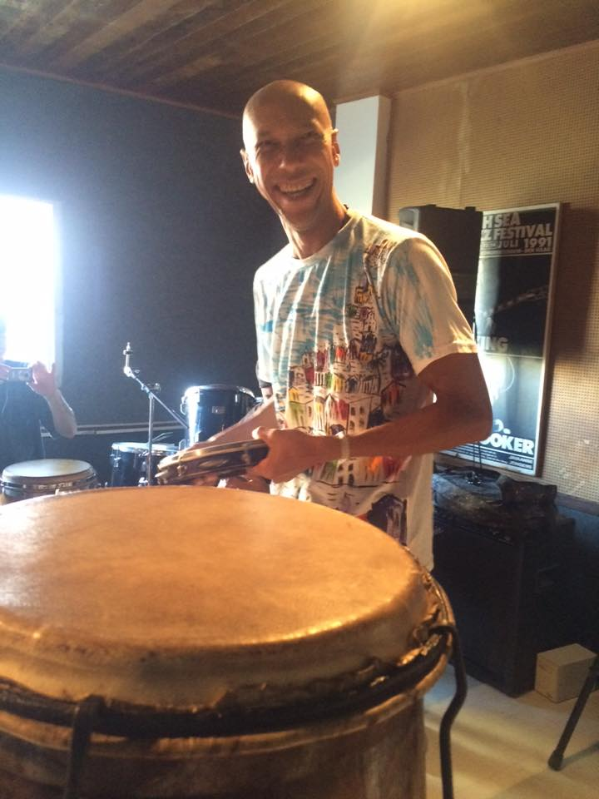

Slide 28
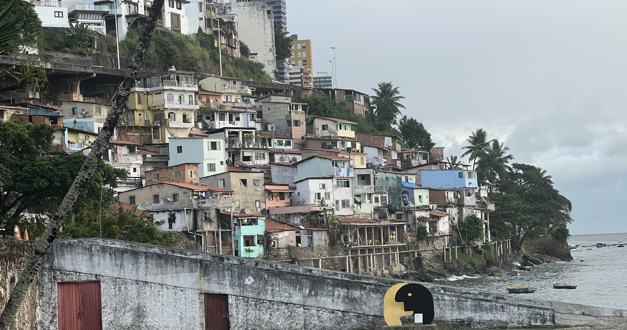

Slide 29
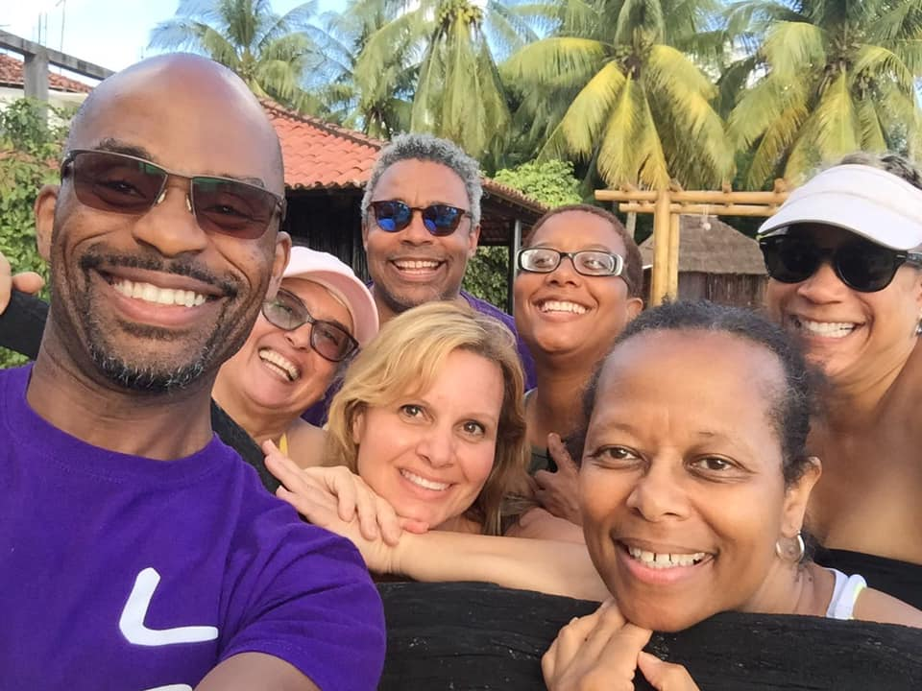

Slide 30
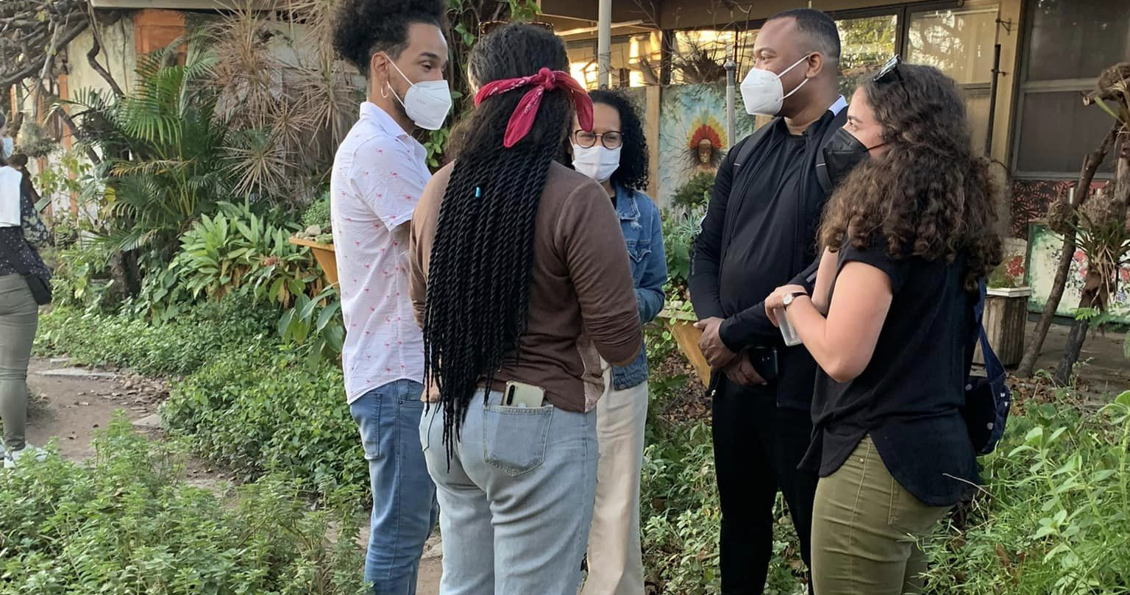

Slide 31
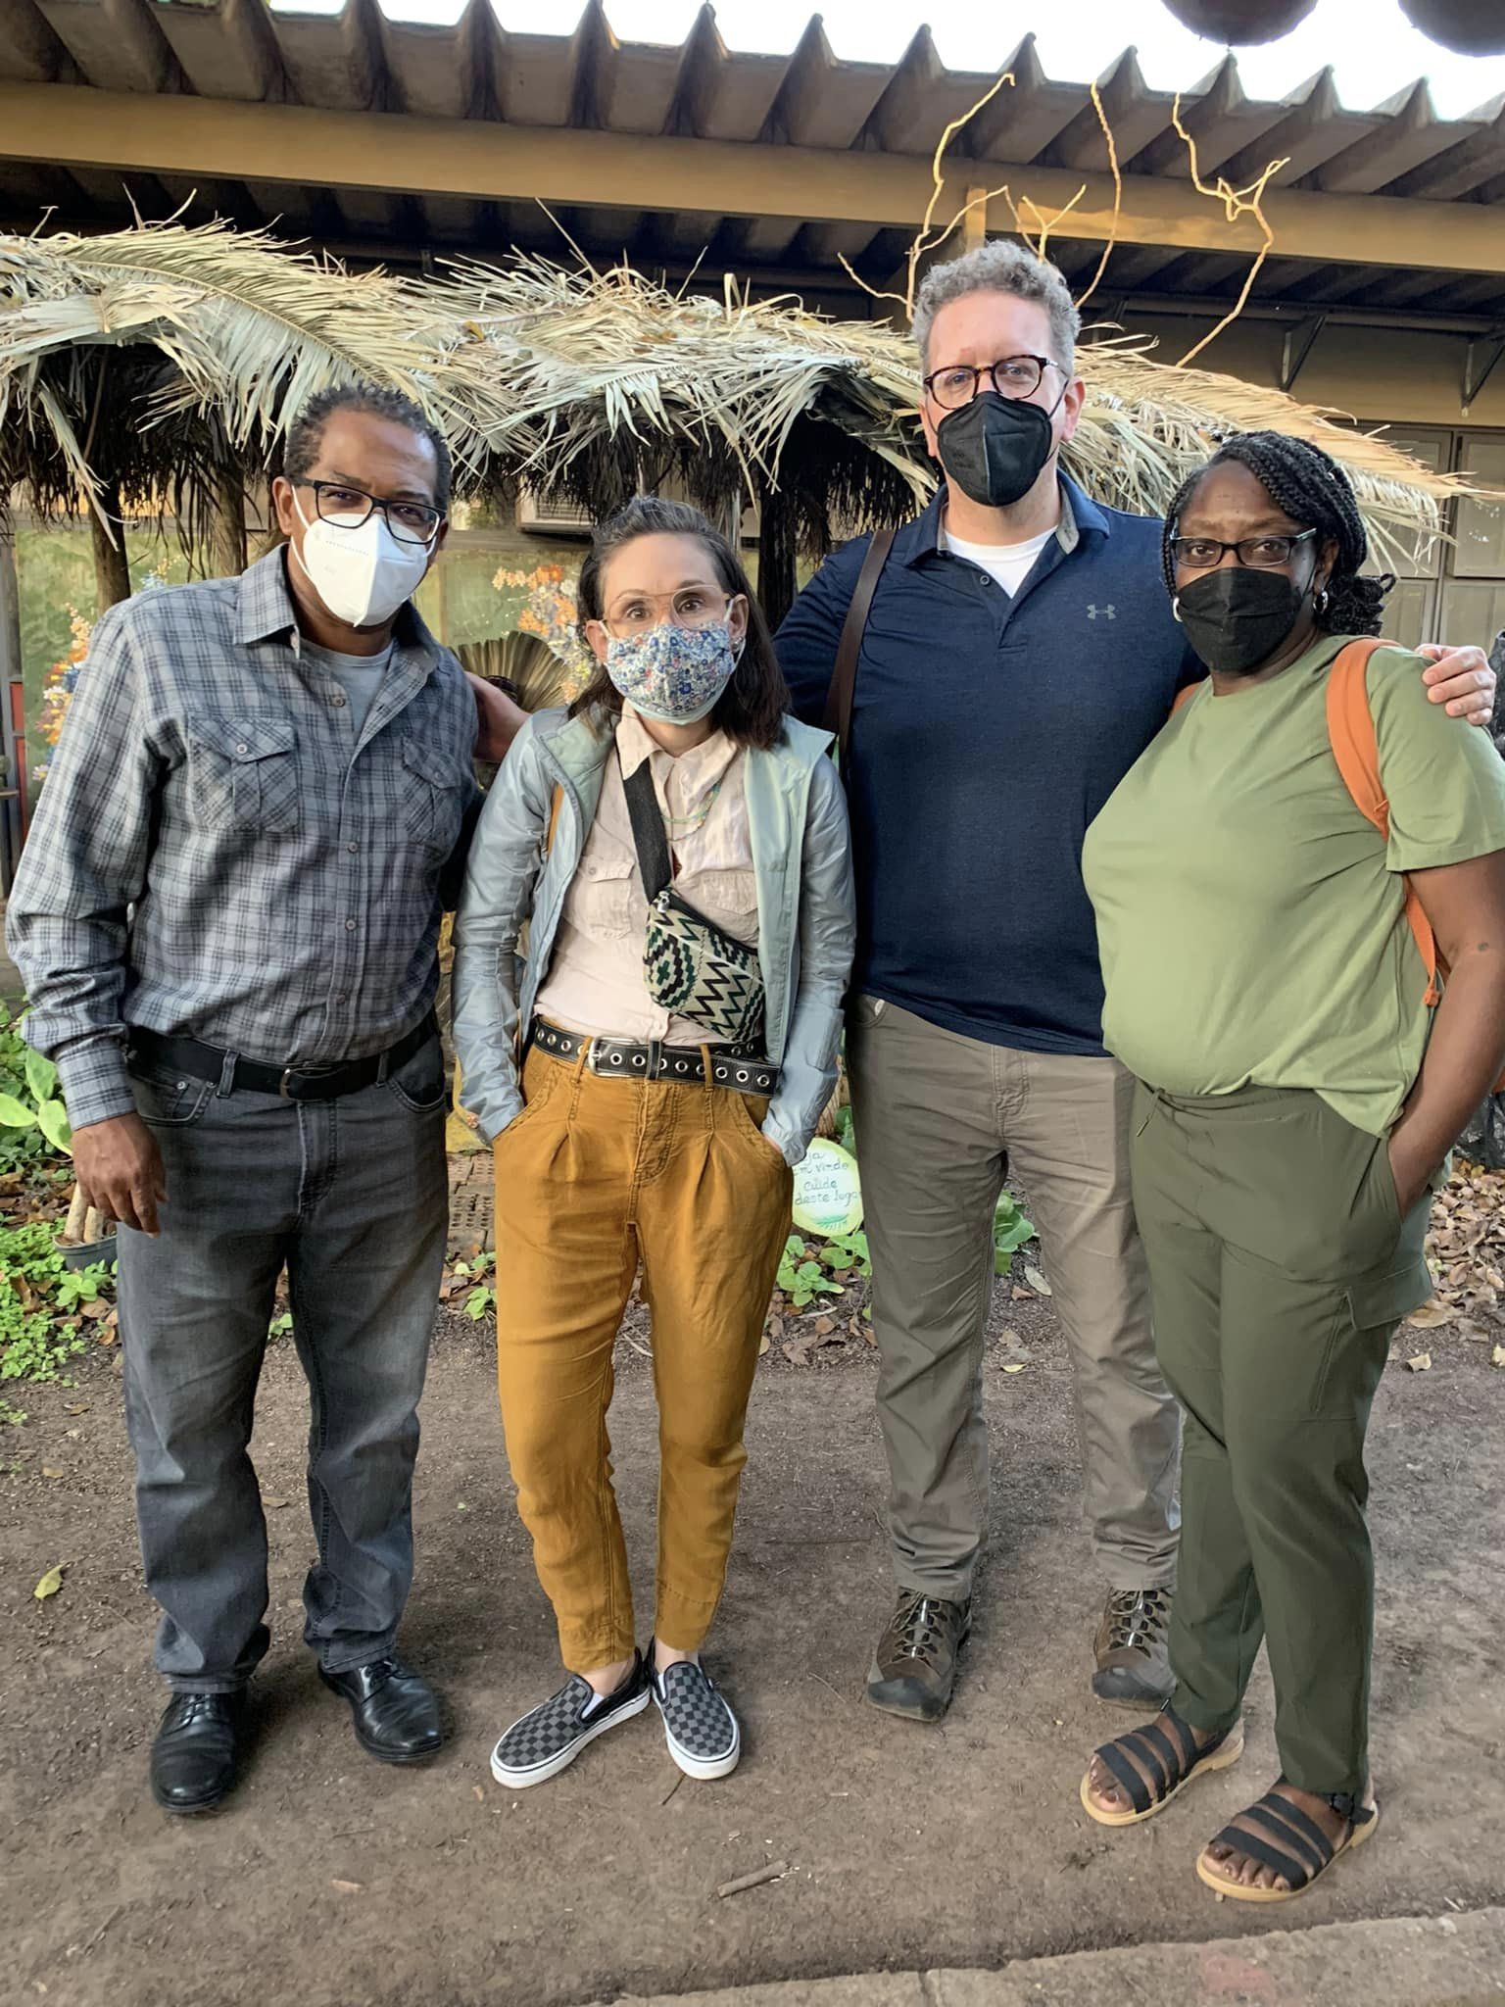

Slide 32
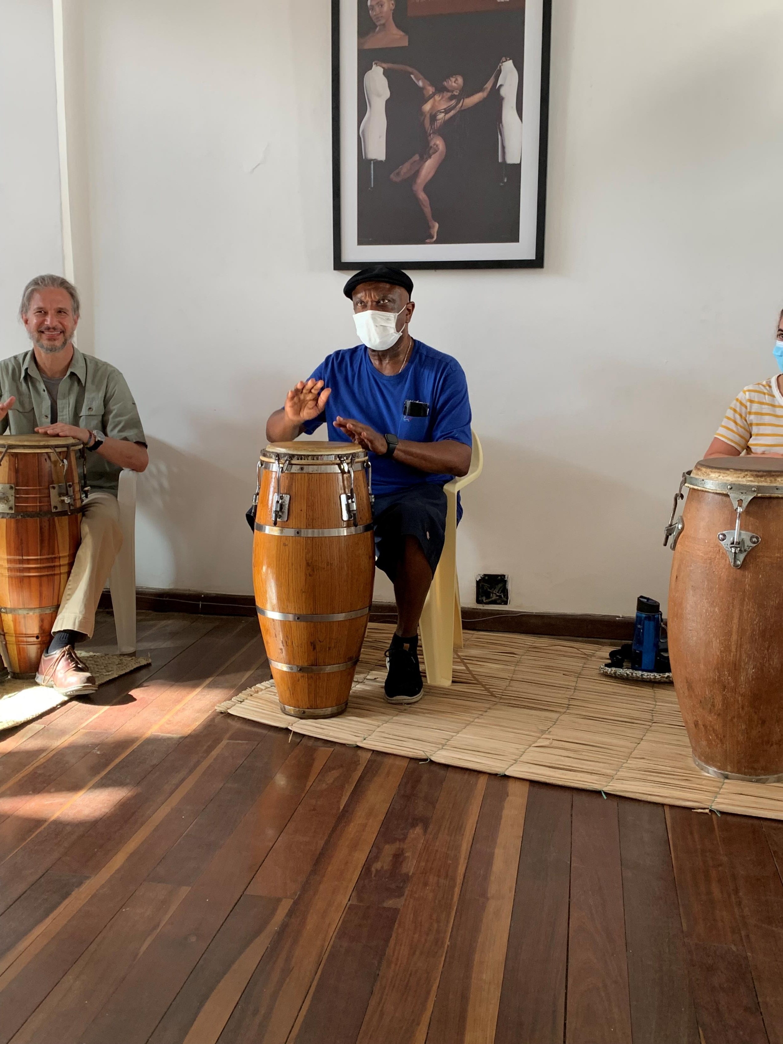

Slide 33


Slide 34
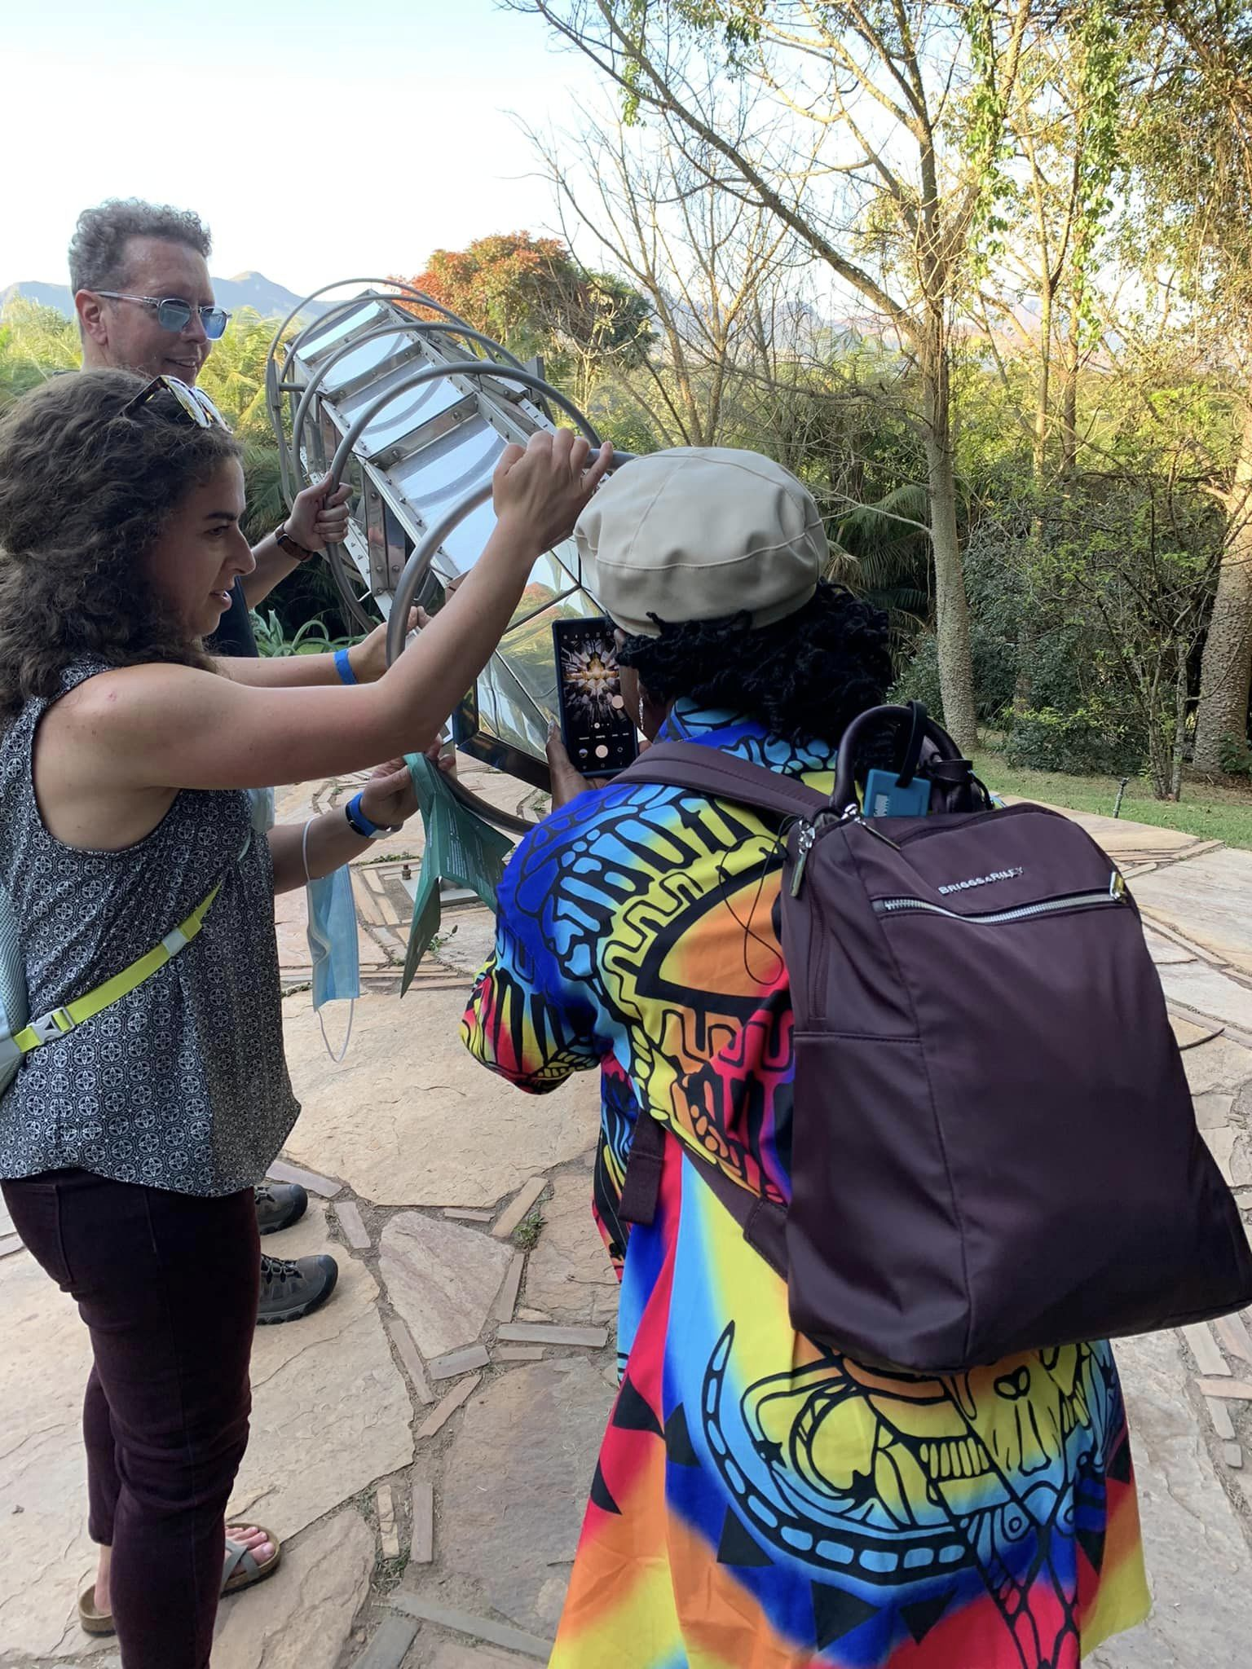

Slide 35
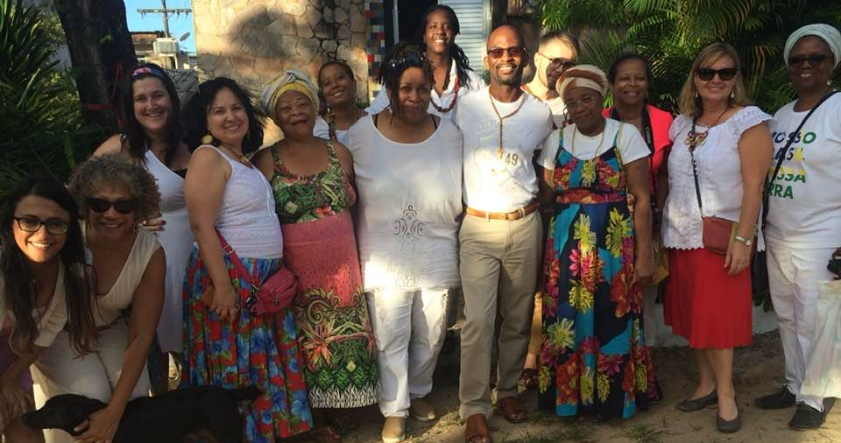

Slide 36
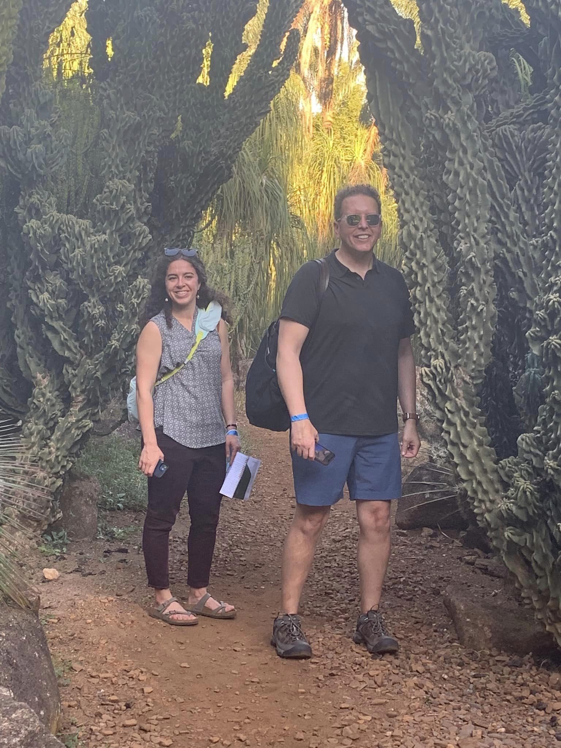

Slide 37


Slide 38
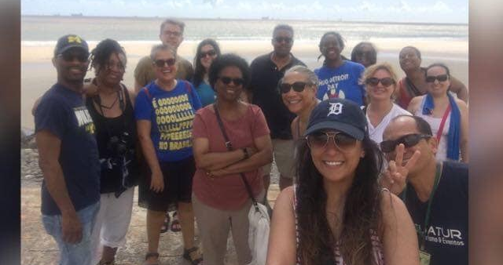

Slide 39
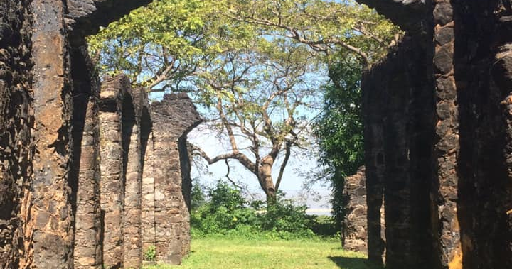

Slide 40
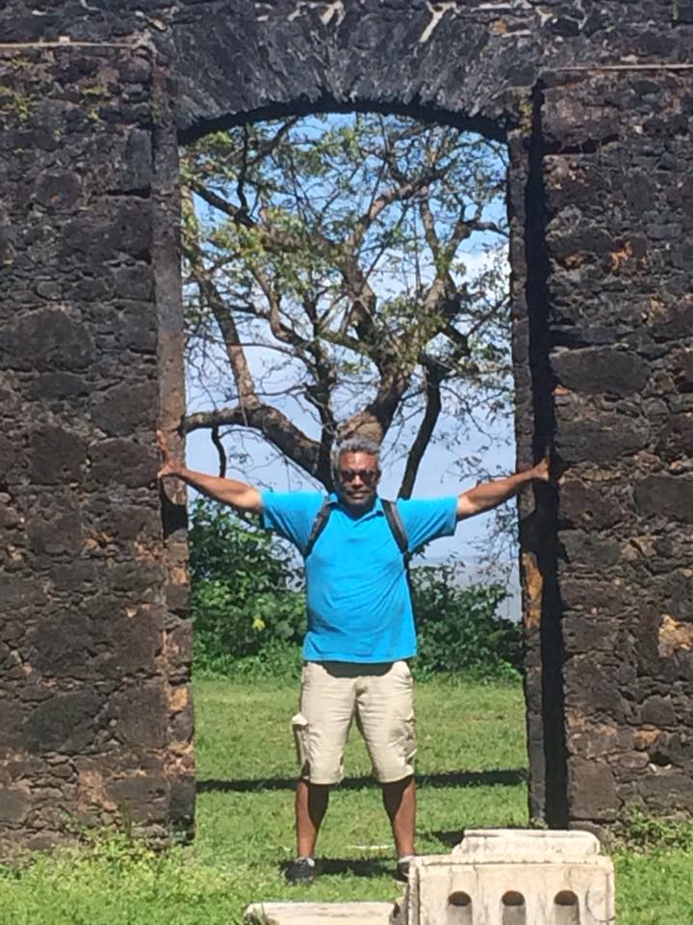

Slide 41
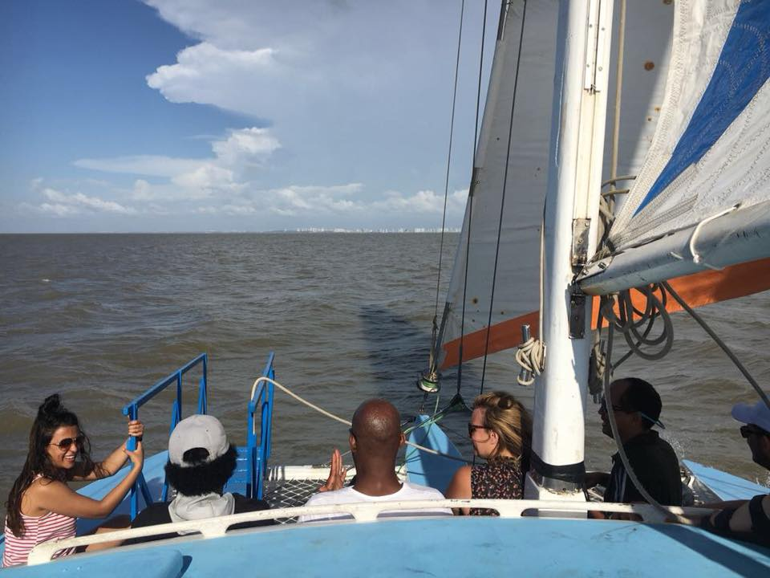

Slide 42
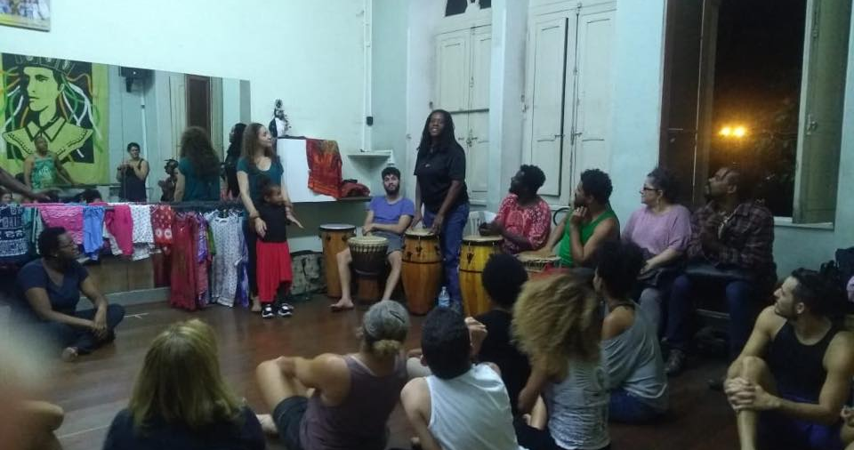

Slide 43
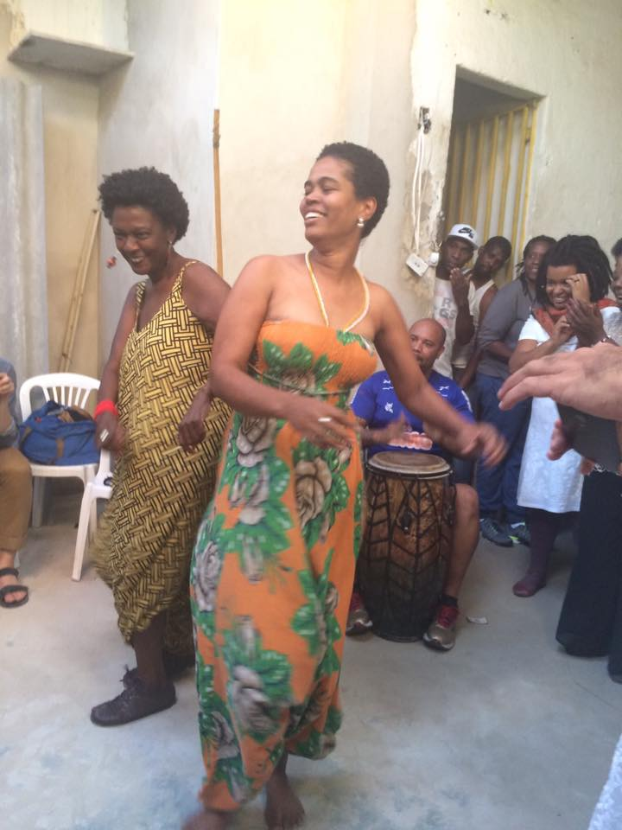

Slide 44


Slide 45


Slide 46
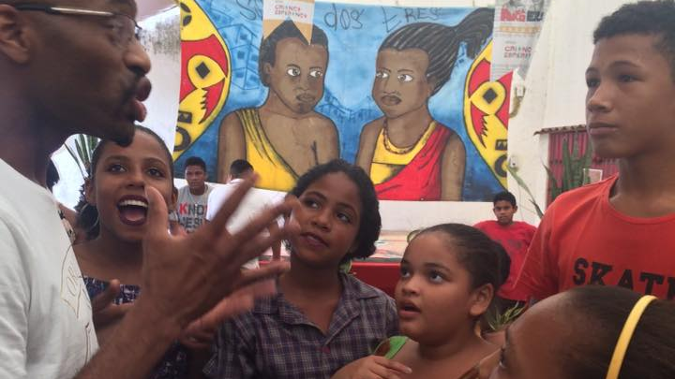

Slide 47
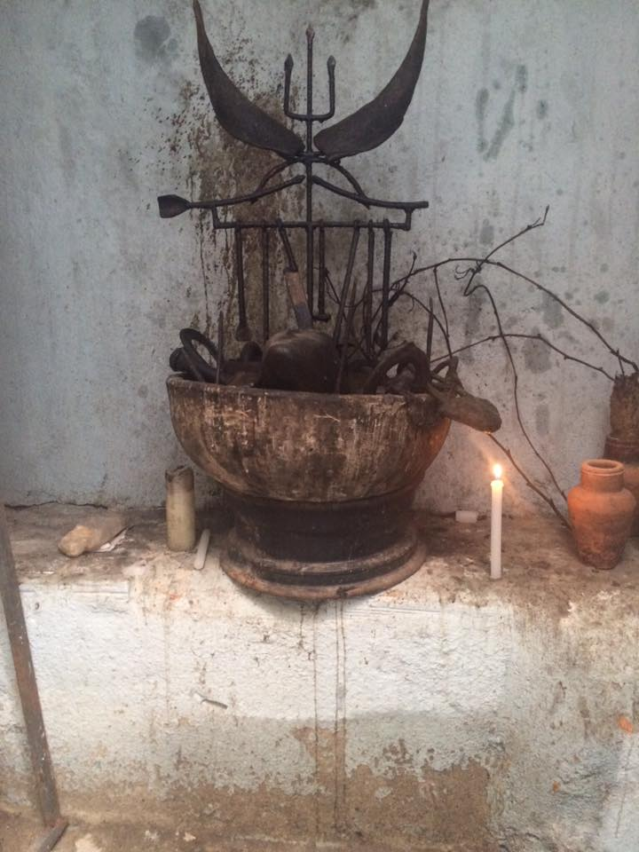

Slide 48
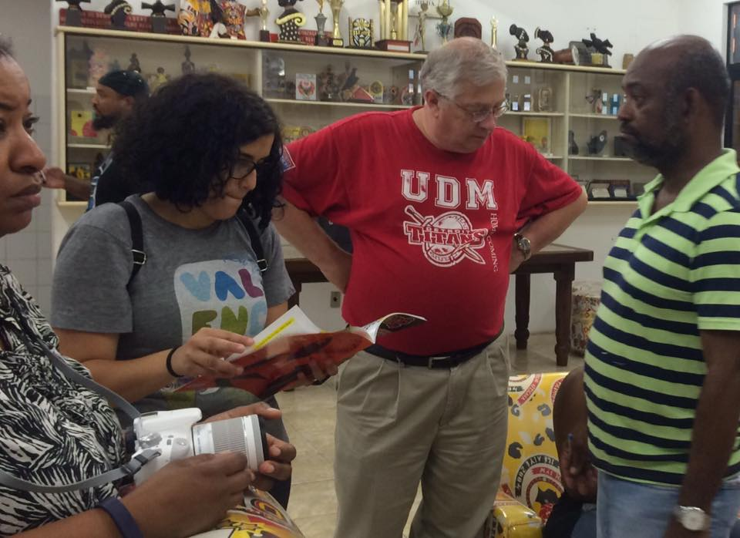

Slide 49
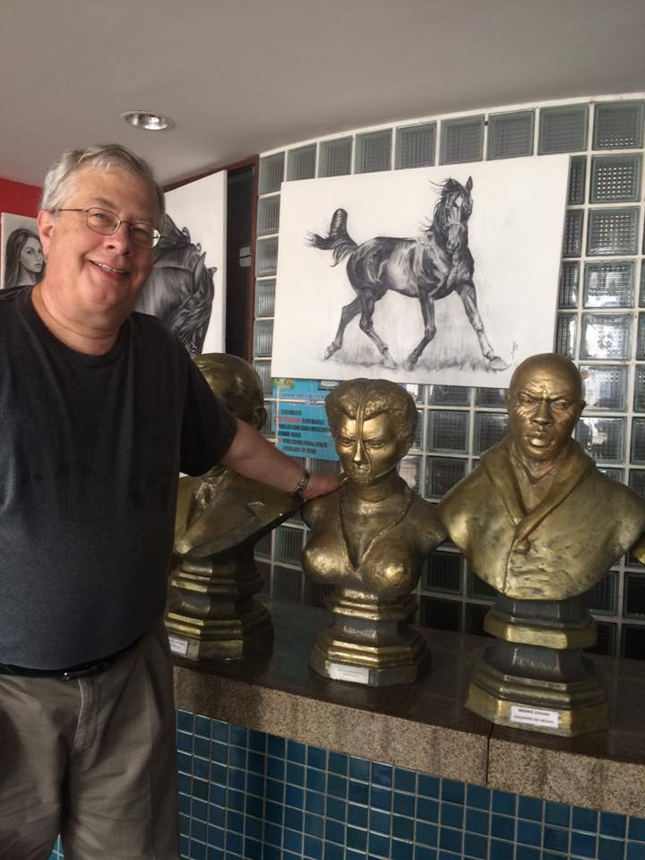

Slide 50
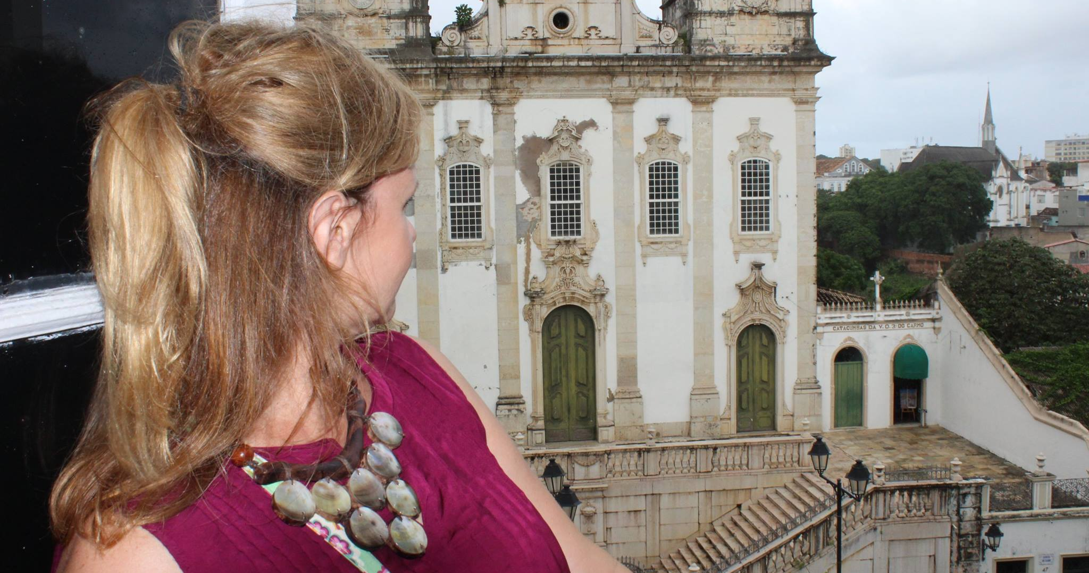

Slide 51
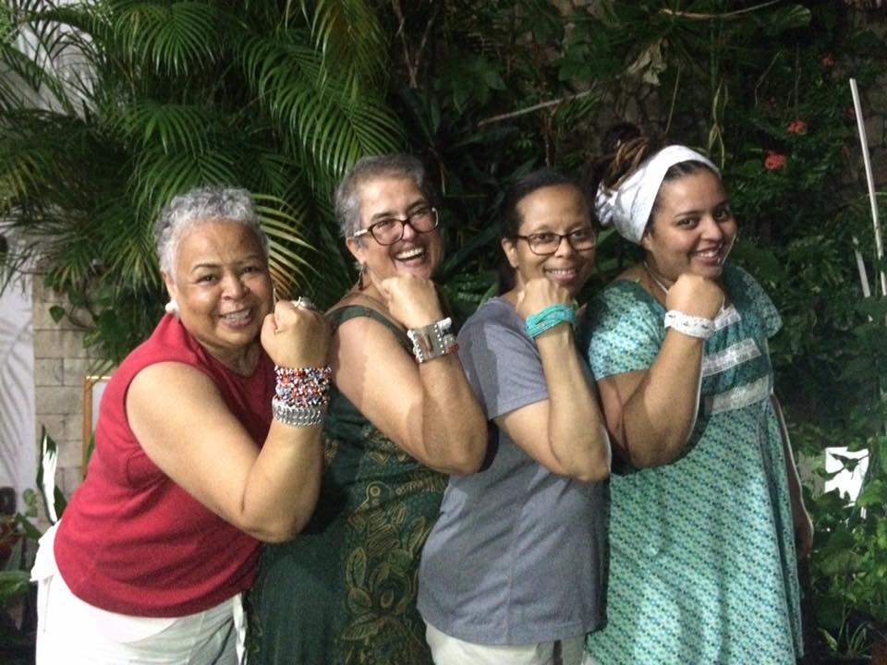

Slide 52
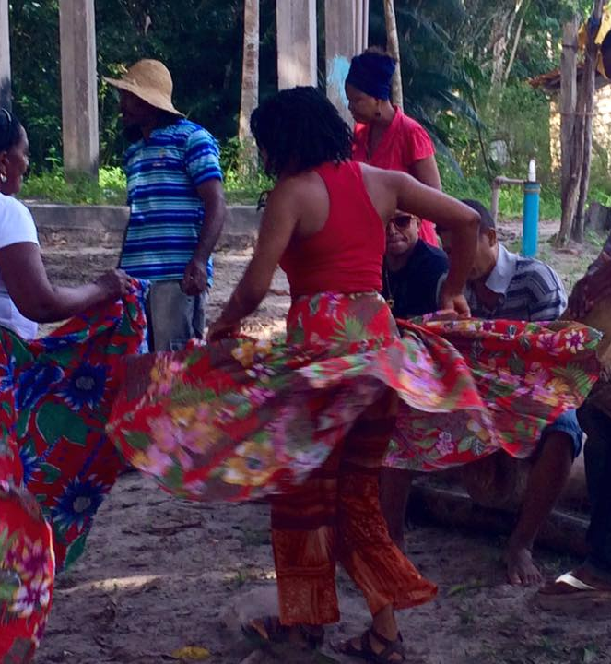
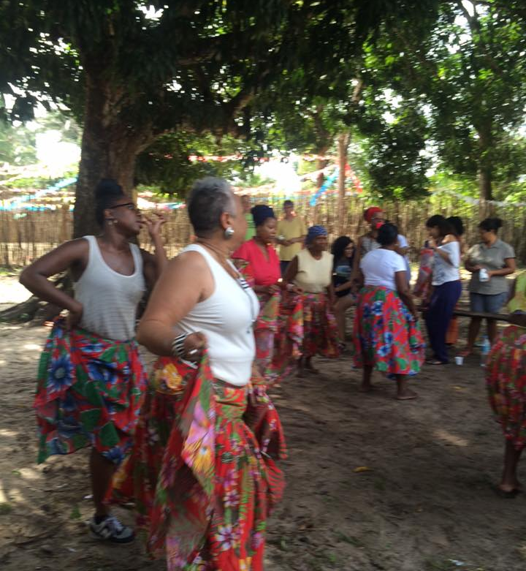

Slide 53


Slide 54
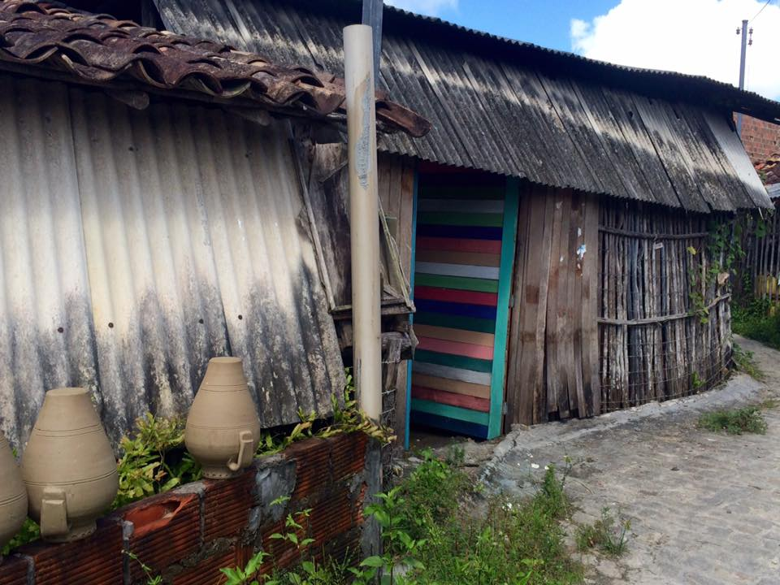

Slide 55
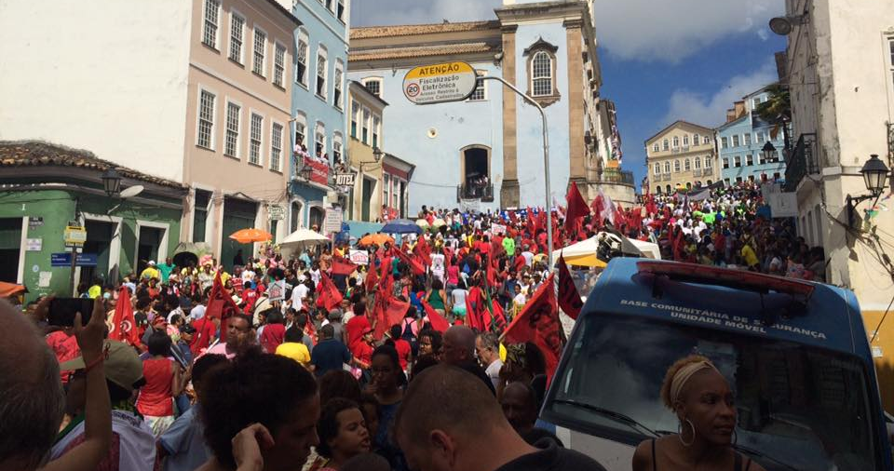

Slide 56
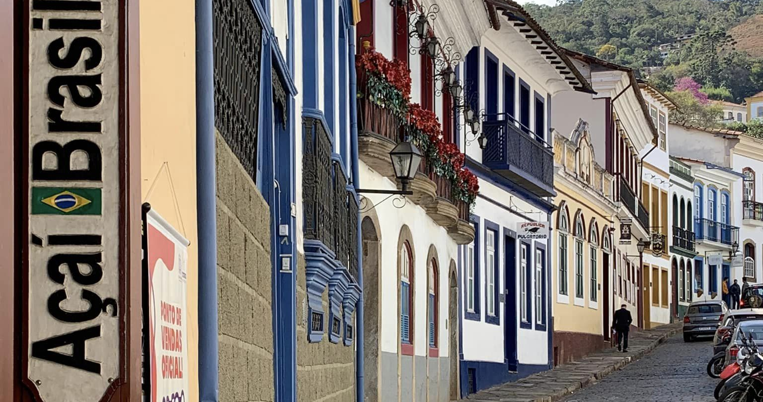

Slide 57
