Slide 1
African American and Afro Brazilian Storytelling :
From Folktales to Magical Realism
Using Cordel (folhetos)Literature to Create Narrative Stories in Rhythm and Rhyme.

Slide 2
Objective
Integrate some of my research into my African American Literature Class
Work with others to develop a writing component on Cordel
Develop a stand alone writing workshop using Cordels as a model for narrative writing.

Slide 3
Guiding Questions
What is Cordel’s importance in Brazilian culture?
What function does the Literatura de Cordel play in Brazilian society?
Why is Cordel different from other narrative storytelling?
What themes, archetypes, motifs are re-occurring in Cordel writing?
How can I use this information in my own writing?

Slide 4
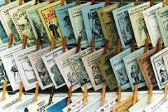
Cordel
Cordel literature are popular and inexpensively printed booklets or pamphlets containing folk novels, poems and songs, which are produced and sold in fairs and by street vendors in Brazil, principally in the Northeast.

Slide 5
Subject Matter
Mother-in-laws
Bandits
Jesus, Mary, and Peter
The devil
Politics
Incidents not covered in the news
Romance
Monsters
The Catholic Church
Cultural Heroes
Social Issues

Slide 6
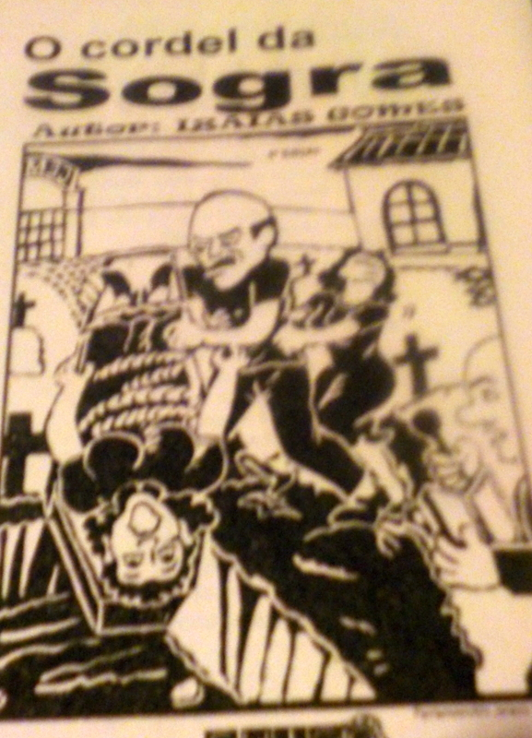
Mother in Laws

Slide 7

Politics

Slide 8
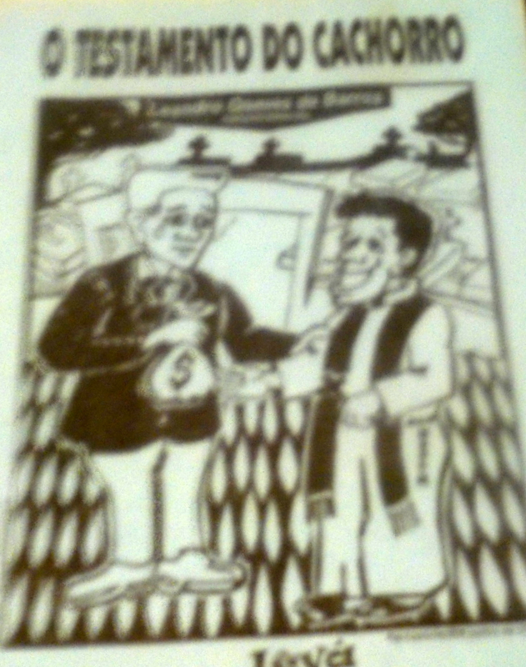
The Catholic Church

Slide 9
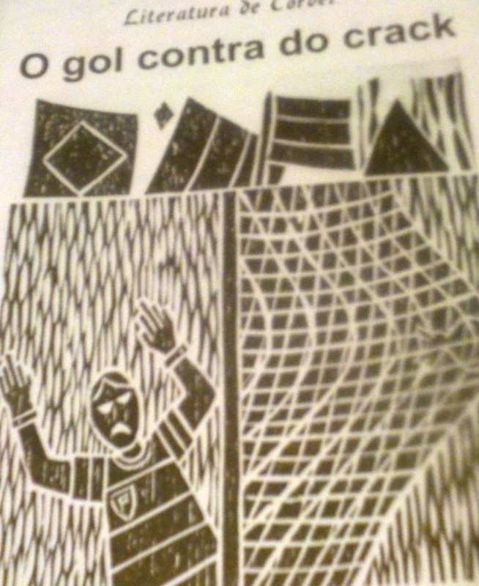
Social Issues

Slide 10
Rhyme Scheme
Sextilha
"O Monstro Do Rio Negro" by José Camelo de Melo Resende
Eu quisera ouvir um homem
dizer-me que resistiu,
ao monstro do Rio Negro
e triunfando saiu
para eu lhe dizer na cara:
você desta vez mentiu.
I'd like to hear a man
say to me that he fought
the monster of the Rio Negro
and left in triumph.
To him, I'd say to his face,
"This time you are really pulling my leg."
ABCBDB
XAXAXA rhymes, with X standing for blank verses
ABBAACCDDC

Slide 11
Heptasyllabic
Seven syllables
O escritor Jorge Amado
E o pintor Caribé
Caymmi o grande cantor
Sabem dizer o que é
A força de Menininha
Rainha do Candomblé.
The writer Jorge Amado
And the painter Caribé
Caymmi the great singer
All give credit to the
force of Menininha
Queen of the Candomblé.
No batuque na Mãe África
em noite de devoção
fez-se samba e lundu
no banzo da solidão
do cansaço, dos chicotes
nas costas em punição.
The drumming of Mother Africa
during the night of devotion
became the samba and lundu
from the solitude, the longing for home,
the fatigue, the punishing whips
on their backs.

Slide 12
There are three major types of Cordelian poems
The oral, improvised poetic duel in written form called the peleja.
“Traditional” popular literature, largely in a fiction mode dealing with fairy tales or love and adventure. The largest number of poems in Cordel are in this mode.
Non-fiction (in large part) stories which report all manner of current events from the local to the international.

Slide 13
Brazilian improvised verse dialogues or contests called desaﬁos or pelejas and repente
    https://www.youtube.com/watch?v=p5P_gzlw1gY
    https://www.youtube.com/watch?v=bLpJSFIItic

Slide 14
The Raven Cordel
https://www.youtube.com/watch?v=lQnG9HlWok0
Two young men, their futures bright
Instead, they choose a valiant cause.
they leave the city to settle in
a border town where men break laws
to rescue slaves and send them North.
These two young men, now called outlaws
https://www.youtube.com/watch?v=vU8i7Oe1ayI
At every turn they meet their foe
and trick the catcher of human flesh
to save the slave whose only crime
non-Christian and therefore he is less
than men who live off others’ work and think this makes them better, best.

Slide 15
Resources
http://www.brazzil.com/pages/cvrjan02.htm
Curran, Mark J. Adventures of a "Gringo" Researcher in Brazil in the 1960's: Or, in Search of "cordel" N.p.: Trafford, 2012. Print.
https://www.facebook.com/BrazilianLanguage/posts/162404927245714
http://researchguides.library.wisc.edu/cordel_literature
Slater, Candace. Stories On A String: The Brazilian Literatura de Cordel. Berkeley: University of California Press. 1982

